Slide 1
Azure Data Lake Storage

Slide 2
Introduction to ADLS

Slide 3
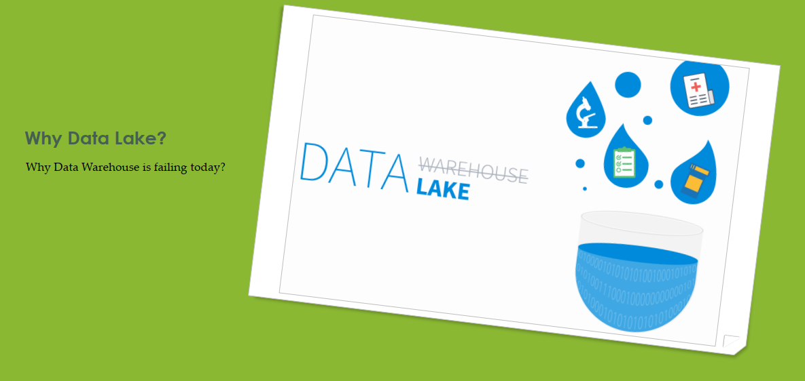
Why Data Lake?

Slide 4
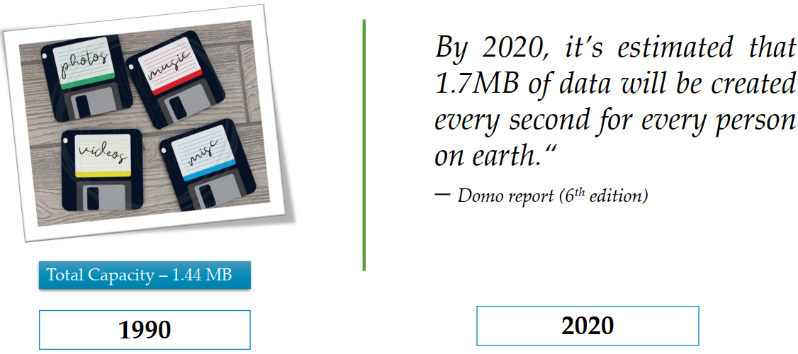
Once upon a time

Slide 5
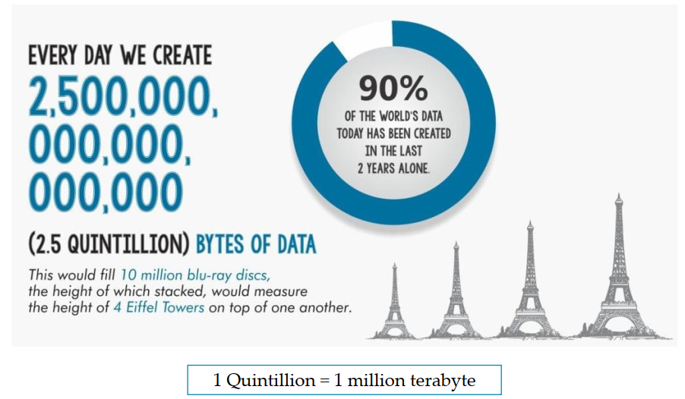
How much data we create daily?

Slide 6
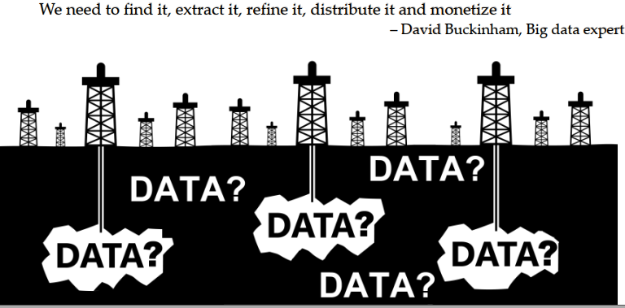
Data is now new oil

Slide 7
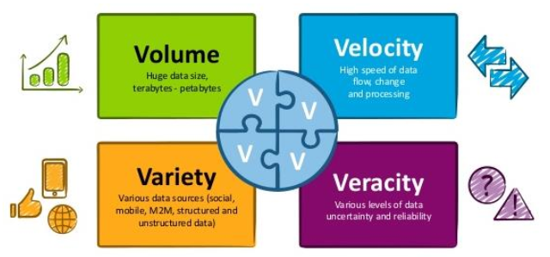
Problem statement
Need a solution which can handle below 4 V’s of data.

Slide 8
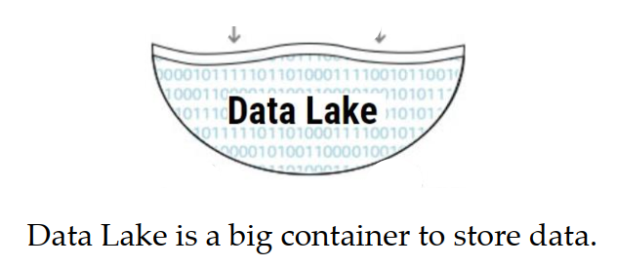
Introduction to Data Lake

Slide 9
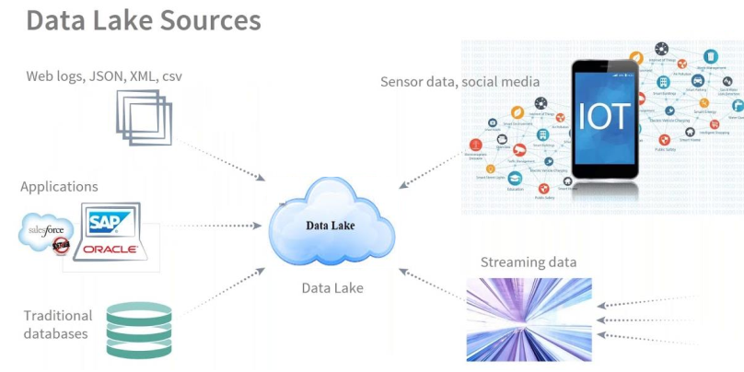
Data Lake Sources

Slide 10

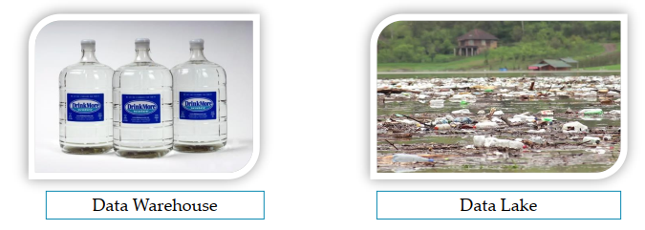
What is Data Lake?
“If you think of a DataMart as a store of bottled water – clean and packaged and structured for easy consumption – the data lake is a large body of water in a more natural state. The contents of the data lake stream in from a source to fill the lake, and various users of the lake can come to examine, dive in, or take samples.”
He coined terminology – “Data Lake”

Slide 11
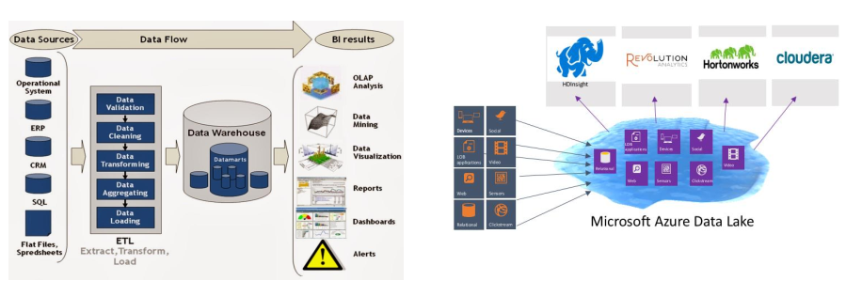
Data Warehouse vs Data Lake
Data warehouse stores data only if it’s usage is first identified
Data is just dumped in Data Lake. Processing is done later on to identify the required data

Slide 12
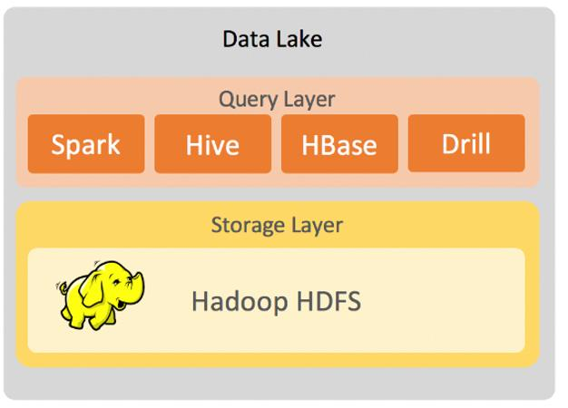
Azure Data Lake Gen1 evolution
HDFS in Cloud is nothing but Data Lake Gen1 in cloud.
Fault tolerant file system
Runs on commodity hardware
MapReduce, Pig, Hive, Spark etc.

Slide 13
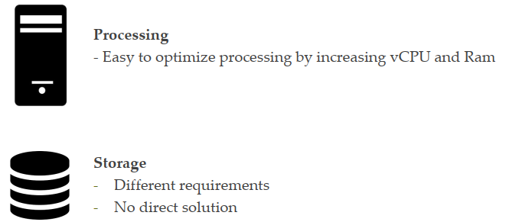
Cloud storage challenge

Slide 14

Large object storage in cloud
Optimized for storing massive amounts of unstructured data
Text or Binary Data
General purpose object storage
Cost efficient
Provide multiple Tiers

Slide 15
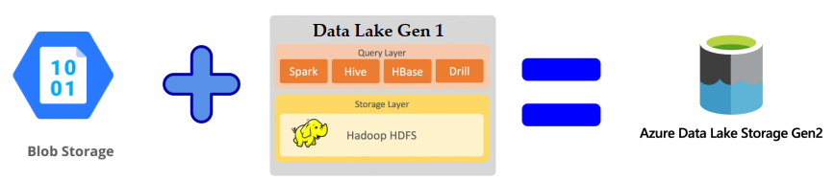
Azure Data lake Gen 2
MICRSOFT RECOMMENDS: Data Lake Storage Gen2

Slide 16
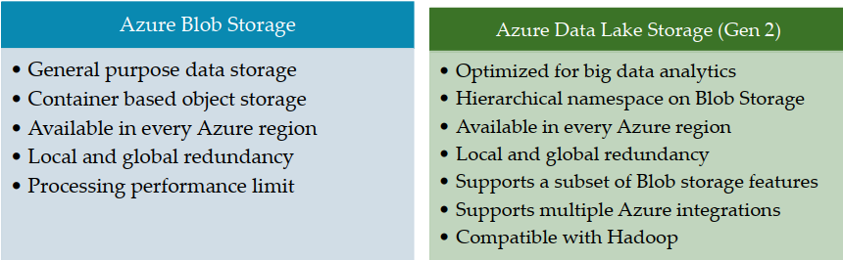
Blob Storage vs Data Lake Storage
Use Gen1 only if USQL is to be used. USQL is currently being supported only in Gen1. USQL is a special
Query language for Big Data.

Slide 17
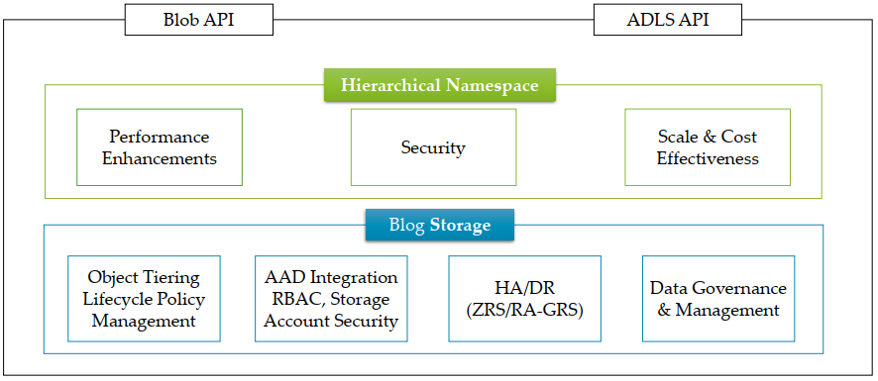
Data Lake Architecture

Slide 18
Hands-On: How to create ADLS Gen2?
How to create ADLS Gen2?

Slide 19
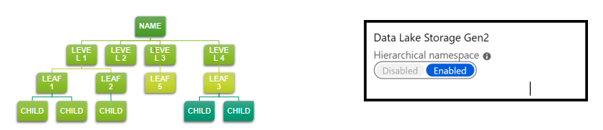
Hierarchical namespace
Hierarchical namespace organizes objects/files into a hierarchy of directories for efficient data access.
Blob storage is not hierarchical namespace
Blob can’t integrate with Hadoop

Slide 20
Hierarchical namespace
Manageable
Performance
Cost
Familiar interface style
When not to use?
Where object organization stored separately
E.g.: Backups, image storage, etc.

Slide 21
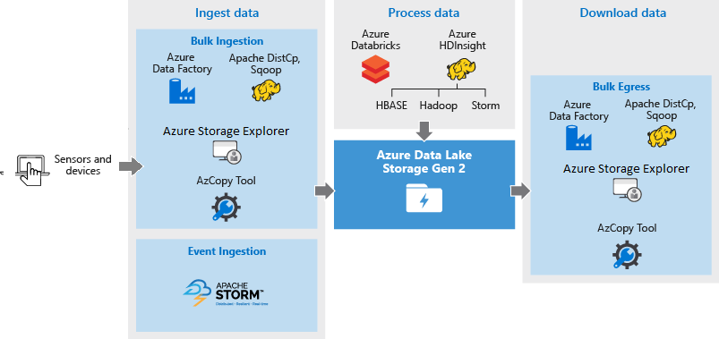
Data Lake Architecture

Slide 22
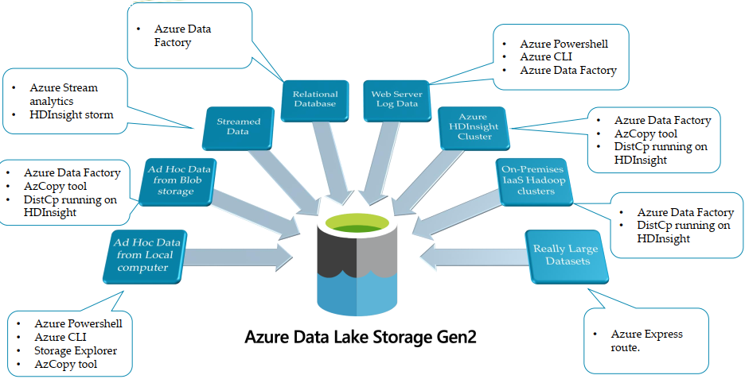
Data Ingestion

Slide 23
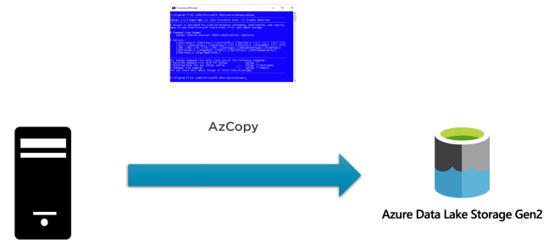
Hands-On: AzCopy

Slide 24
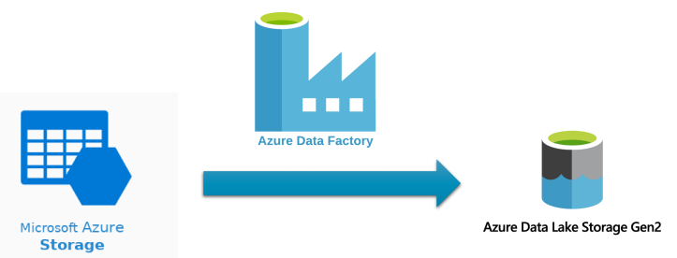
Hands-On: Azure Data Factory: Azure Blob Storage

Slide 25
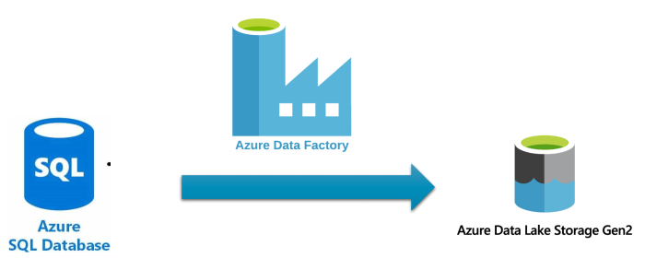
Hands-On: Azure Data Factory: Azure SQL Database

Slide 26
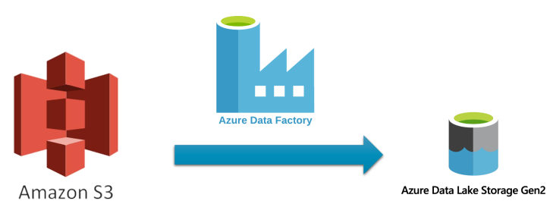
Azure Data Factory: Amazon S3

Slide 27
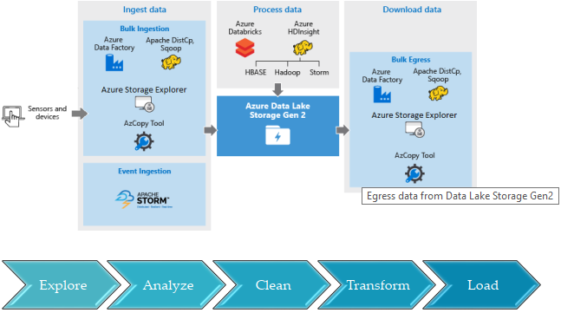
Data flow around Data Lake

Slide 28
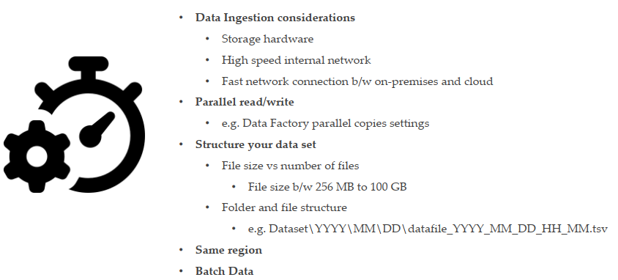
Data Lake Optimization Techniques

Slide 29
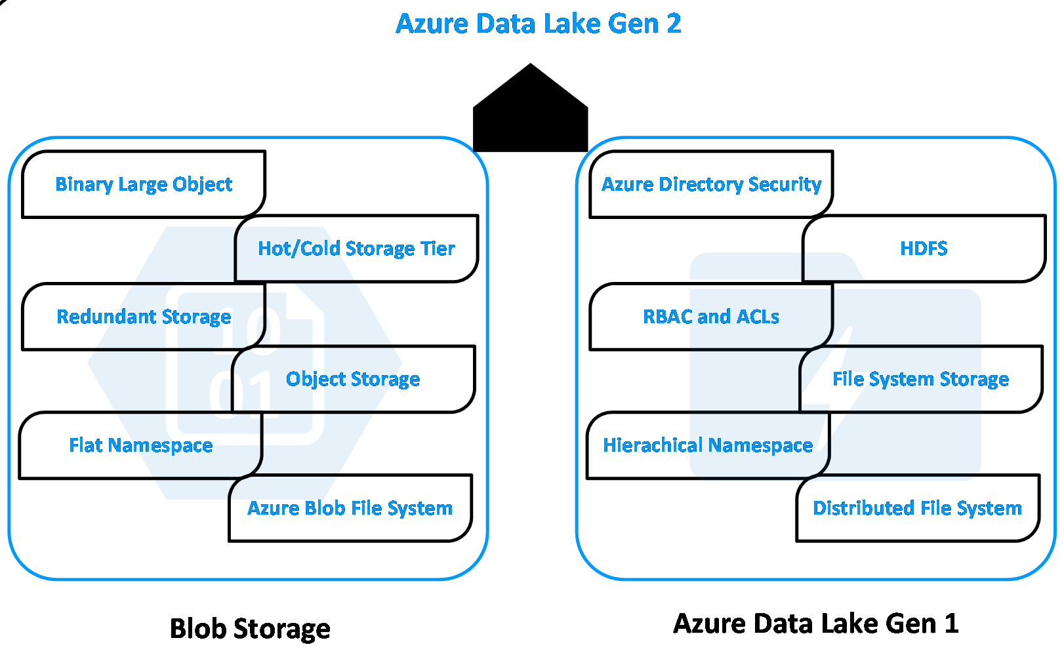

Slide 30
Key Features of ADLS Gen2

Slide 31

Important features of Data Lake Gen2
Integration
POSIX complaint
Hadoop Integration (use ABFS driver)
Other Azure services integration
Scalability
Cost effective
Build on top of Azure low cost blob storage
No need to move data
Hierarchical namespace -> less compute -> save cost
Performance – optimized for high speed throughput

Slide 32
Important features of Data Lake Gen2
Security
Fault tolerant/ High availability/ Disaster recovery
Global footprint
Challenges
Hard to query unstructured data
Hard to manage data quality

Slide 33
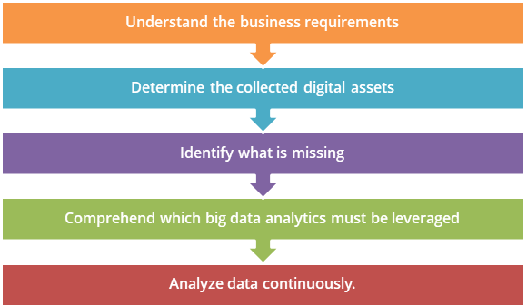
Processing Big Data Best Practices

Slide 34

1. UNDERSTAND THE BUSINESS REQUIREMENTS
Must be carried out
Even before leveraging big data analytics into your projects
Must understand
Which projects in company must use big data analytics to make maximum profit.

Slide 35

2. DETERMINE THE COLLECTED DIGITAL ASSETS
To identify
Type of data pouring into the organization
As well as, the data generated in-house
Disorganized
Data collected is disorganized and in varying formats
Dark Data
Some data is never even exploited
It is essential that organizations identify this data too.

Slide 36
Dark Data
Acquired but not used
To derive insights or for decision making
Not aware
Organizations may not even be aware that the data is being collected
IBM estimate
That roughly 90 percent of data generated by sensors and analog-to-digital conversions never get used

Slide 37
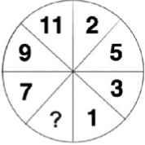
3. IDENTIFY WHAT IS MISSING
Identify additional information
Once collected the data, identify additional information required and
Its sources
Example: To understand employee's well-being
Along with information such as login logout time, medical reports, and email reports, we need to have some additional information about the employee’s, let’s say, stress levels
This information can be provided by co-workers or leaders.

Slide 38
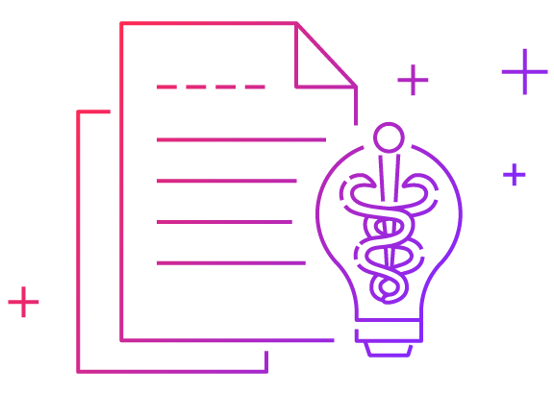
4. COMPREHEND WHICH BIG DATA ANALYTICS MUST BE LEVERAGED
Figure out
Which big data technologies can be best used for the current business requirements
Such as
Predictive analytics,
Stream analytics,
Data preparation,
Fraud detection,
Sentiment analysis etc.

Slide 39
5. ANALYZE DATA CONTINUOUSLY
Be Aware
Of what data is lying with your organization and what is being done with it
Check health of data
Periodically to never miss out on any important but hidden signals in the data

Slide 40
Hands-on: Security Layers in Data Lake

Slide 41


